Slide 1
Data analysis

Slide 2
Data analysis is an aspect of data science and data analytics that is all about analyzing data for different kinds of purposes. The data analysis process involves inspecting, cleaning, transforming and modeling data to draw useful insights from it.

Slide 3
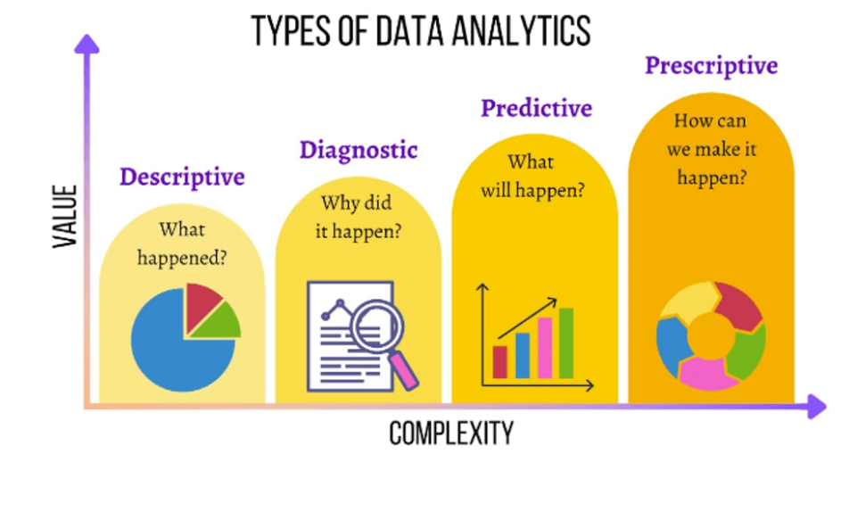

Slide 4
Descriptive Analytics
Descriptive analytics is a type of data analysis that focuses on describing and summarizing data to gain insights into what has happened in the past. It is commonly used to answer questions such as “What happened?” and “How many?”.
Descriptive analytics can help businesses and organizations understand their data and identify patterns and trends that can inform decision-making.
Here are some real-life examples of descriptive analytics:
A retail store might analyze historical sales data to identify popular products and trends. For example, people tend to buy more candy in February.
Patient data can be summarized to identify common health issues. For example, most people get the flu from October to June.
Student performance data can be analyzed to identify areas for improvement. For example, most students who fail Calculus are frequently late to class.
To use descriptive analytics effectively, you need to ensure that your data is accurate and of high quality. It’s also crucial to use clear and concise visualizations to communicate insights effectively.

Slide 5
Predictive Analytics
Predictive analytics uses statistical and machine learning techniques to analyze historical data and predict future events. It is commonly used to answer questions such as “What is likely to happen?” and “What if?”.
Predictive analytics is useful as it can help you plan ahead. It can help improve business operations, reduce costs, and increase revenue. For example, you can predict how sales will likely behave based on seasonality and previous sales figures. If your predictive analysis tells you that sales will likely decrease in winter, you can use this information to design an effective marketing campaign for this season.
Here are some practical examples of predictive analytics in action:
A bank might use predictive analytics to assess credit risk and determine whether to grant a loan to a customer. In open banking, predictive analytics can help build highly personalized behavioral models specific to each customer and identify their creditworthiness in new ways. For customers, this may mean better and cheaper access to bank accounts, credit cards, and mortgages.
In marketing, predictive analytics can help identify which customers are most likely to respond to a particular offer.
In healthcare, predictive analytics can be used to identify patients at risk of developing a particular disease.
In manufacturing, predictive analytics can be used to forecast demand and optimize supply chain management.
However, there are also some challenges to using predictive analytics effectively. One challenge is the availability of high-quality data essential for accurate predictions. Another challenge is selecting appropriate modeling techniques to analyze the data and make accurate predictions. Finally, communicating predictive analytics results to decision-makers can be challenging, as the techniques used can be complex and difficult to understand.

Slide 6
Prescriptive Analytics
Prescriptive analytics is a type of data analysis that goes beyond descriptive and predictive analytics to provide recommendations for actions you should take. In other words, this approach involves using optimization techniques to identify the best course of action, given a set of constraints and objectives.
It is commonly used to answer questions such as “What should we do?” and “How can we improve?”
To be effective, it requires a deep understanding of the data being analyzed and the ability to model and simulate different scenarios to identify the best course of action. As such, this is the most complex approach of the four methods.
Prescriptive analytics can help you solve various problems, including product mix, workforce planning, marketing mix, capital budgeting, and capacity management.

Slide 7
The best example of prescriptive analytics in action is using Google maps for directions during peak hours. The software considers all modes of transport and traffic conditions to calculate the best route possible. A transportation company might use prescriptive analytics in this way to optimize delivery routes and minimize fuel costs. This is important especially when you consider the rising cost of fuel. In Canada, for example, the average person spends approximately $2,000 annually per vehicle on fuel alone, while in the United States households are spending almost 2.24% of their total annual income on fuel.
However, like with predictive analytics, there are some challenges to using prescriptive analytics effectively. The first challenge is the availability of high-quality data essential for accurate analysis and optimization. Another challenge is the complexity of the optimization algorithms used, which can require specialized skills and knowledge to implement effectively.

Slide 8
Diagnostic Analysis
Diagnostic analytics is a type of data analysis that goes beyond descriptive analytics to identify the root cause of an issue or problem. It answers questions such as “Why did it happen?” and “What caused it?”. For example, you can use diagnostic analysis to determine why your January sales dropped by 50%.
Diagnostic analytics involves exploring and analyzing data to identify relationships and correlations that can help explain an issue or problem. This can be done using techniques such as regression analysis, hypothesis testing, and causal analysis.
Real-life examples include:
You can use diagnostic analysis to identify the root cause of a quality issue in your production process.
You can also use it to identify the cause behind a customer’s complaint and provide a targeted solution.
In case of a cyber threat, you can also use it to identify the source of a security breach and prevent future attacks.
There are many benefits to using diagnostic analytics, such as identifying the underlying causes of issues and problems and developing targeted solutions. But, like with the previous two data analytics methods, there are some challenges to consider. For one, acquiring high-quality data and ensuring accurate analysis and insights can be difficult. Secondly, the analysis techniques can be quite complex and may require specialized skills and knowledge to be implemented effectively.

Slide 9
